Slide 1

R language and data analysis
Qiang Shen (沈强)
College of Economics and Management, Zhejiang University of Technology
13675883767, johnsonzhj@gmail.com

Slide 2
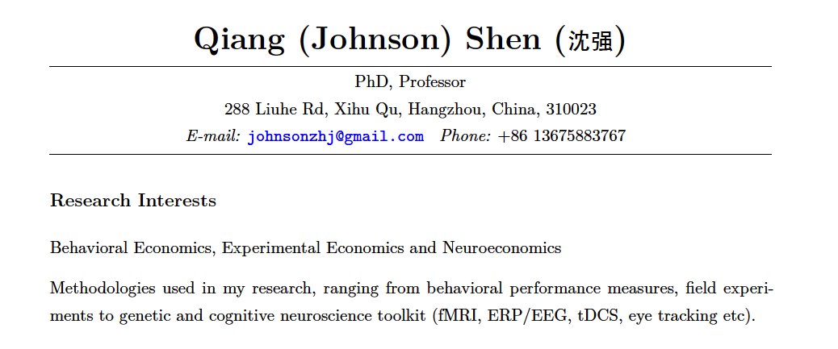
https://github.com/johnsonzhj/R-course-2017-winter

Slide 3
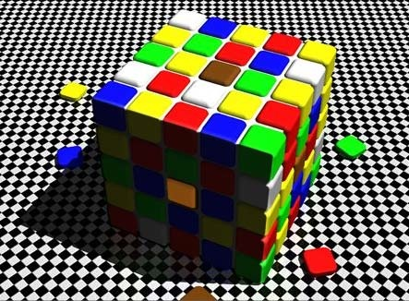
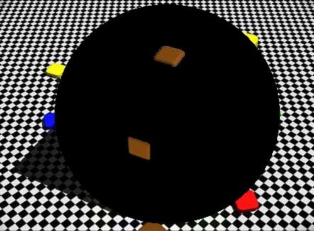
Cognitive bias

Slide 4
Projection bias
Projection bias is a feature in human thinking in which one thinks that others have the same priority, attitude or belief that one harbours even if that is unlikely.

Slide 5
Hindersight bias
This bias the inclination, after an event has occurred, to see the event as having been predictable, despite there having been little or no objective basis for predicting it.

Slide 6
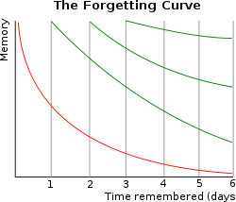
H.Ebbinghaus

Slide 7
Grades
20% attendance
30% homework
10% presentation
40% Final work

Slide 8
Aim
Use R to run your own analysis!
Learning by doing.
Simple, flexible and useful!

Slide 9
Books
R in action. Robert Kabacoff. Manning Publications，2015, 2nd edition http://www.statmethods.net/ textbook 1
R语言实战（第2版）人民邮电出版社, 2016
Hadley Wickham, Garrett Grolemund R for Data Science Import, Tidy, Transform, Visualize, and Model Data O‘Reilly Media 2016.12 textbook 2
Hadley Wickham; Garrett Grolemund 数据科学: R语言实现（影印版）[R for Data Science], 2017-10 东南大学出版社
R Graphics Cookbook, Winston Chang, O'Reilly Media, Inc, 2013
Advanced R (Chapman & Hall/CRC The R Series) 2014-09
The Art of R Programming, Norman Matloff No Starch Press, 2011
Garrett Grolemund,‎ Hadley Wickham Hands-On Programming with R: Write Your Own Functions and Simulations,2014
数据科学中的R语言 李舰 肖凯，西安交通大学出版社，2015
R数据分析——方法与案例详解.方匡南 电子工业出版社.2015

Slide 10
websites
English, Google (http://www.ggfwzs.com/)
http://www.r-bloggers.com
http://stackoverflow.com/
统计之都

Slide 11
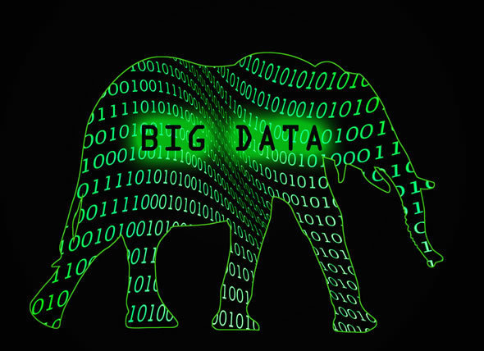
Data science

Slide 12

Data science

Slide 13
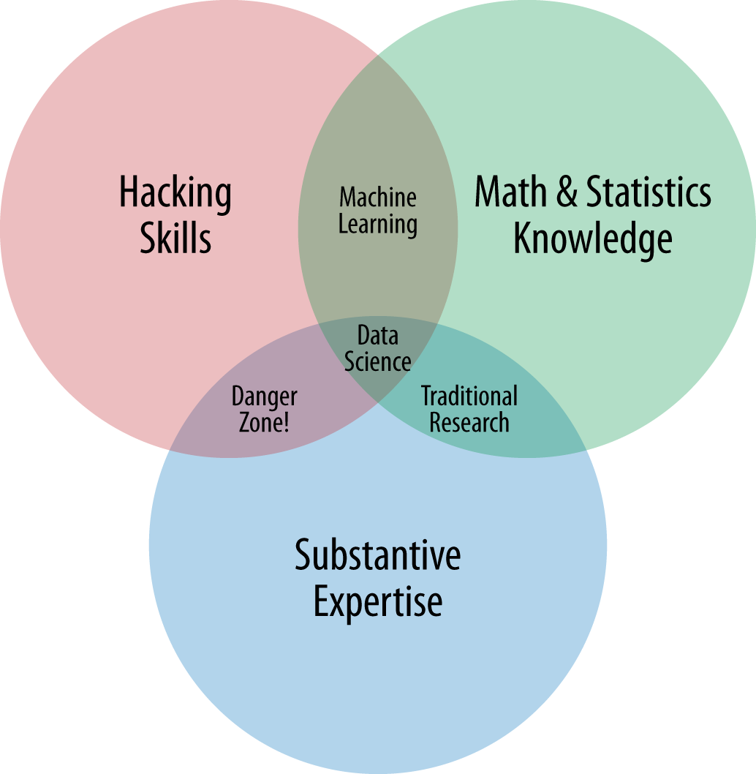
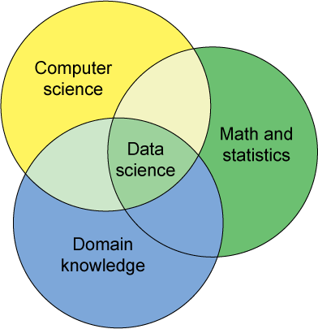
Data science
Drew Conway
IBM

Slide 14
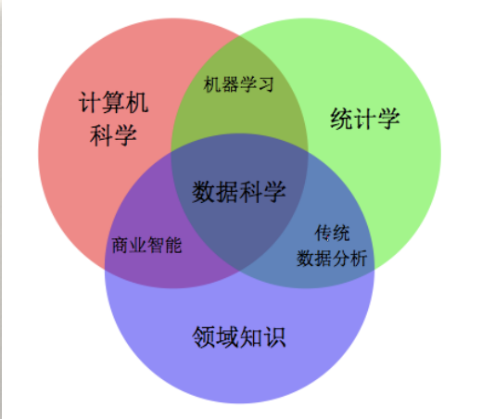
Data science

Slide 15
Data Science
Statistics/Econometrics
Computer science
Domain knowledge
Machine learning （S and C）
Traditional data analysis (S and D)
Business intelligence (C and D)

Slide 16
Business intelligence
“我是搞数据分析的，学会了如何从DW中用SQL对数据ETL并建立了Cube。然后算啊算啊算，得出结论：今年2月份营业收入远远小于其它月份。我试图用spss、sas中的数据挖掘模型找出原因但至今无果。扫地阿姨弱弱的说“2月份是春节，几乎所有的公司半个月无人上班…”我勒个去…..！

Slide 17
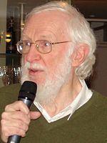
History of Data science
Concise Survey of Computer Methods,1974
Peter Naur,1960

Slide 18

History of Data science
Statistics = data science?
C.F. Jeff Wu,1997

Slide 19
History of Data science
2008, DJ Patil and Jeff Hammerbacher used the term "data scientist" to define their jobs at LinkedIn and Facebook, respectively.
Data Scientists

Slide 20
Data science
What is data science?
Data Science is the extraction of knowledge from large volumes of data that are structured or unstructured which is a continuation of the field data mining and predictive analytics, also known as knowledge discovery and data mining (KDD).
使用科学的方法从数据中获取知识的学科

Slide 21
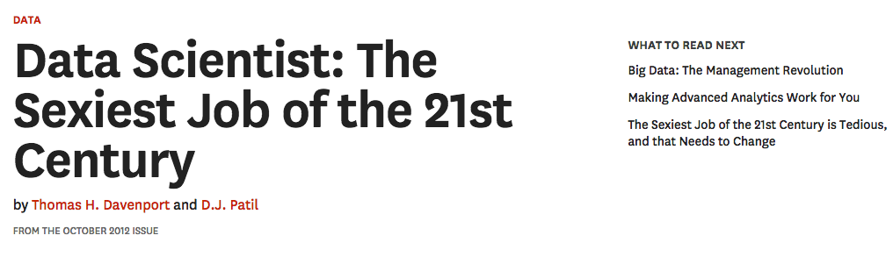
Data science

Slide 22
境界
第一重境界：昨夜西风凋碧树。独上高楼，望尽天涯路；
第二重境界：衣带渐宽终不悔，为伊消得人憔悴；
第三重境界：众里寻他千百度，蓦然回首，那人却在灯火阑珊处。
--王国维 《人间词话》

Slide 23
境界
Run the analysis
Understand the principle
Create your own analysis： tourism

Slide 24


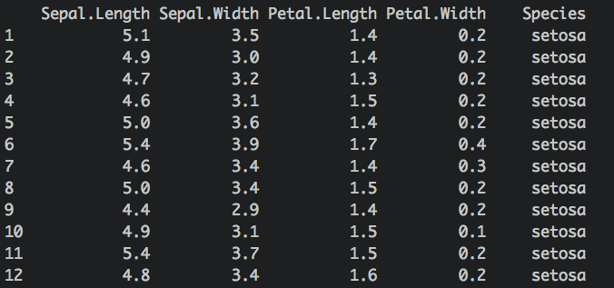
What is data?
the First Lady of the Internet:Lenna

Slide 25
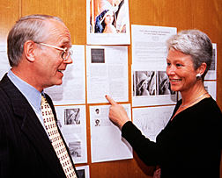
50th Anniversary IS&T conference

Slide 26

R YOU Ready?
What?
Why?
How?
The very beginning mind itself is the most accomplished mind of
true enlightenment
—-Avatamsaka Sutra（华严经）

Slide 27
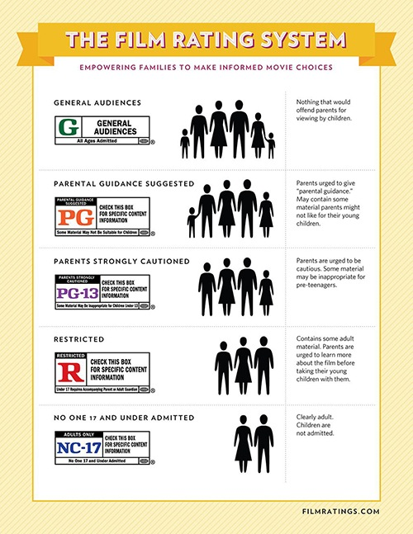
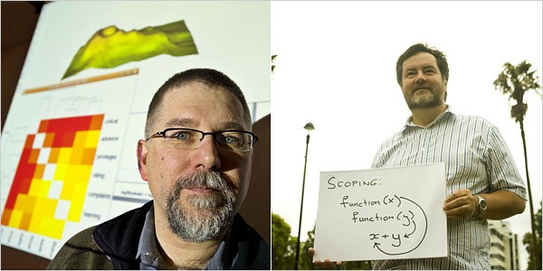
What is R?
R letter
R movie ratings？
Robert Gentleman and Ross Ihaka

Slide 28

What’s R?

Slide 29
R language
R is a language and environment for statistical computing and graphics
https://cran.r-project.org/

Slide 30
Why R?
Statistics: SAS
Computer science: Fortran
Domain knowledge：Excel (VBA)
Machine learning: Python(scikit-learn)
Traditional data analysis (SPSS)
Business intelligence (RapidMiner,SAP, ORACLE, IBM)

Slide 31

Why R?
Excel
SPSS
Stata
SAS
disdain chain

Slide 32
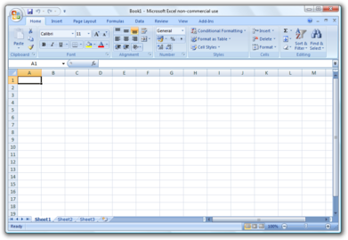
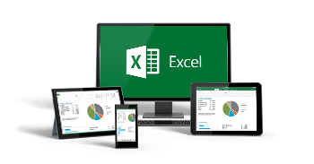
Excel: Domain knowledge
VBA
Regression: Analysis ToolPak
Mac:StatPlus

Slide 33
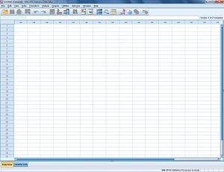



SPSS:Traditional data analysis
SPSS（Statistical Product and Service Solutions)
medicine, psychology and social sciences
Modeler

Slide 34

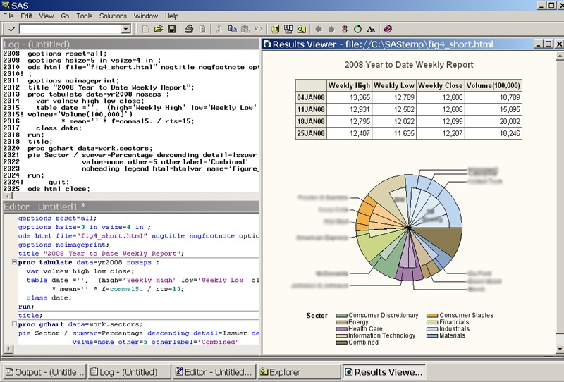
SAS:Statistics
SAS is short form Statistical Analysis System。
权威、许多美国公司使用。
价格不菲、占用空间大
尽管现在已经尽量“傻瓜化”，仍然需要一定的训练
才可以进入。对于基本统计课程则不那么方便。

Slide 35
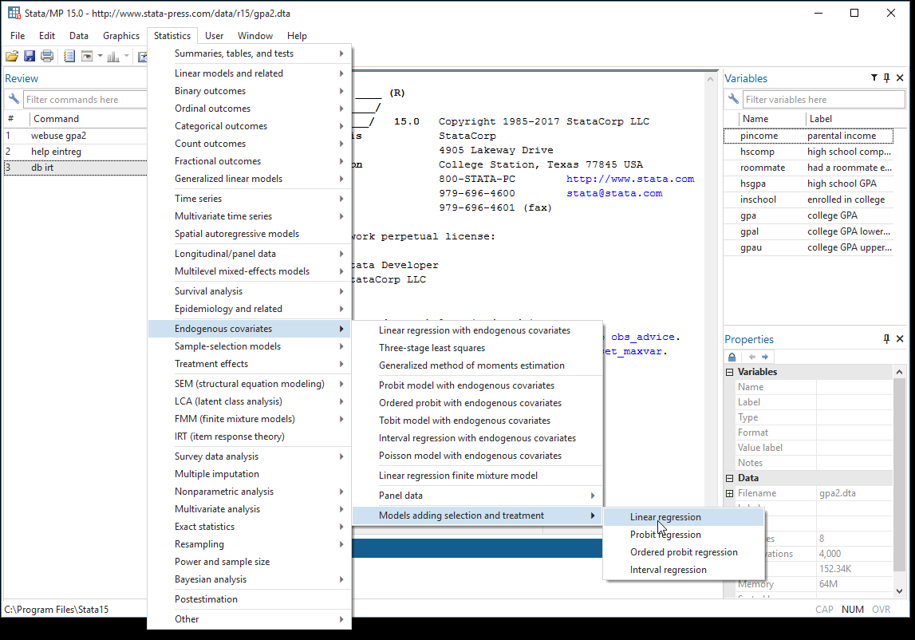

Stata: econometrics
Stata

Slide 36
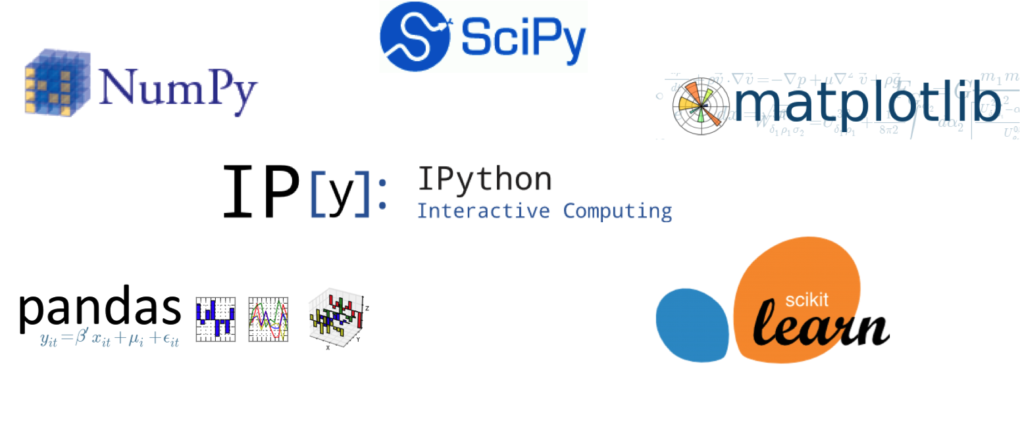
Python

Slide 37
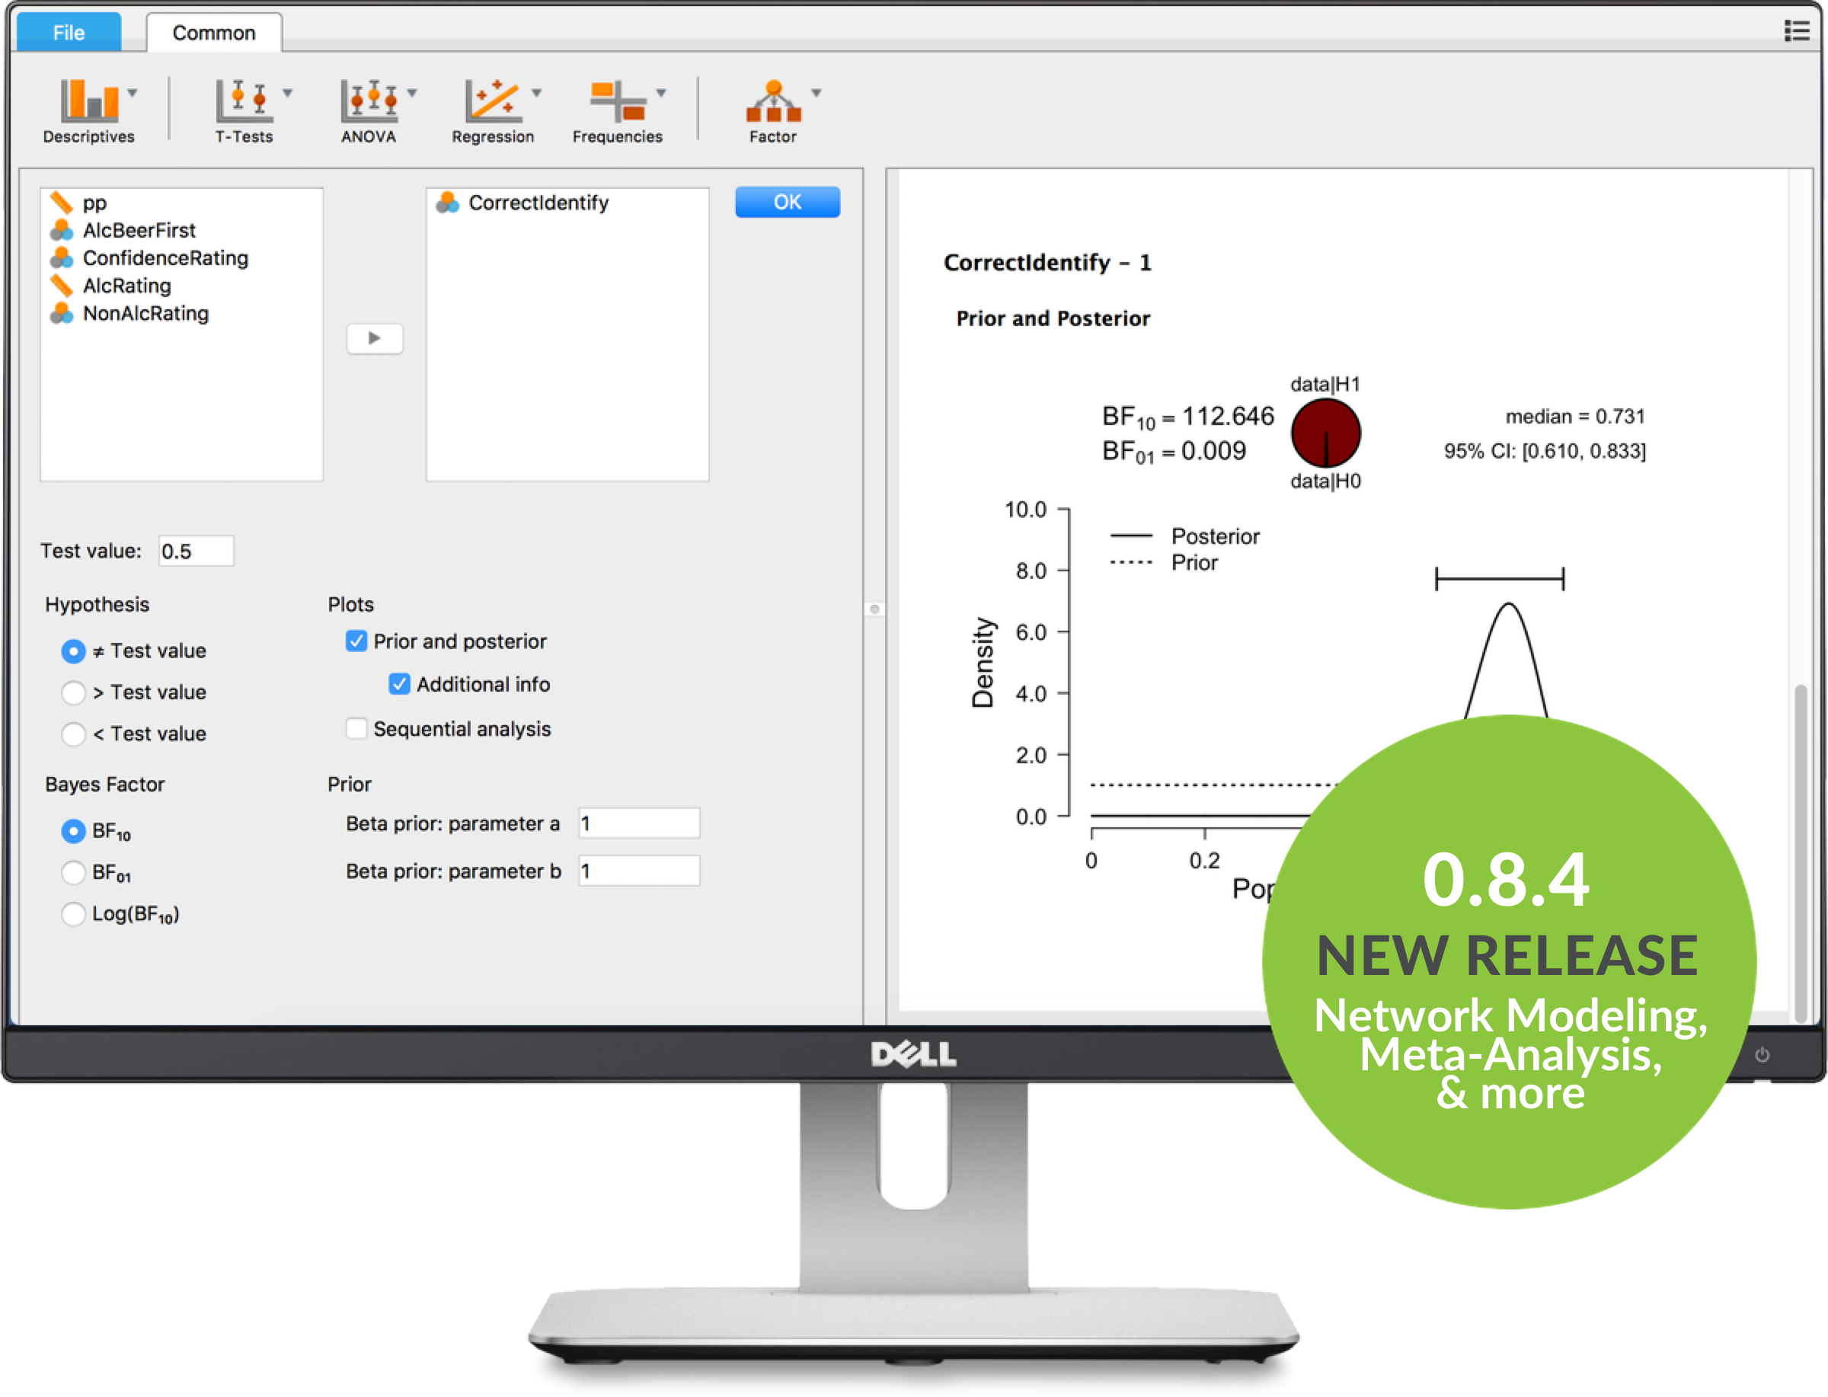

https://jasp-stats.org/
https://julialang.org/

Slide 38
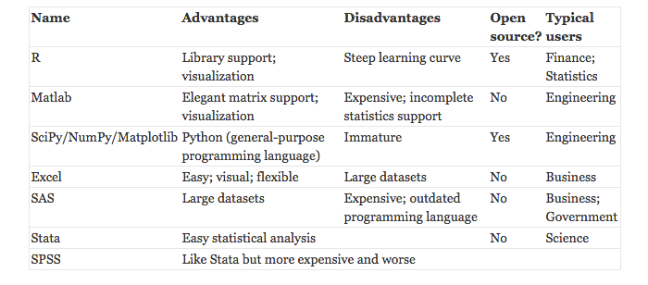
http://stanfordphd.com/Statistical_Software.html

Slide 39
What is R?
R is a dialect of S

Slide 40
History of S
S version 1
John Chambers 1976:Fortran
S version 2
1978
S version 3
1983-1992
rewrite in C 1988
S version4
1995
S won the Association for Computing Machinery(ACM)’s Software System Award in 1998.

Slide 41
History of S
Mathsoft:S-plus
1993
Insightful: Lucent
2004
TIBCO:insightful
2008

Slide 42
Philoshphy of S
“We wanted users to be able to begin in an interactive environment, where they did not consciously think of themselves as programming. Then as their needs became clearer and their sophistication increased, they should be able to slide gradually into programming, when the language and system aspects would become more important.”
--John Chambers

Slide 43
History of R
1991: Created by Ross Ihaka and Robert Gentleman.
1993: First announcement of R to the public.
1995: GNU General Public License to make R free software.
1997: The R Core Group is formed (20 people).
2000: R version 1.0.0 is released.
2017.11: R version 3.4.3
Notes:
https://www.r-project.org/contributors.html

Slide 44
Features of R
free and open source
visualisation
multiple data source
fast upgrade and packages
cross platform
Reproducible
Interact with other software

Slide 45
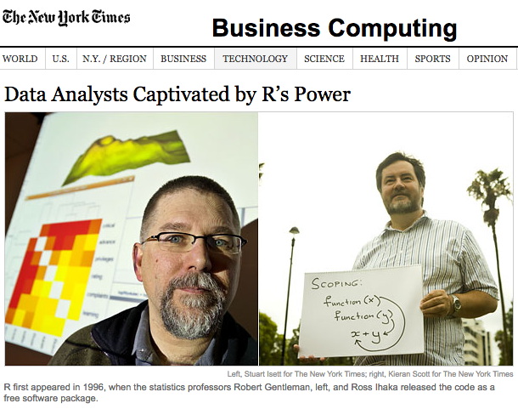
Free and open source!
Reliable?

Slide 46
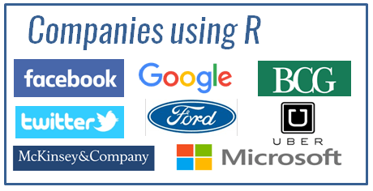
Companies using R

Slide 47
Visualization
install.packages('quantmod')
require(quantmod)
sse<-getSymbols("^SSEC",from = “2005-01-01”
,to = Sys.Date(),src = "yahoo")
SSEC.m<-to.monthly(SSEC)
candleChart(SSEC.m,theme="white")

Slide 48
SSEC

Slide 49
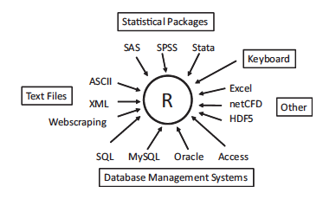
multiple data source

Slide 50
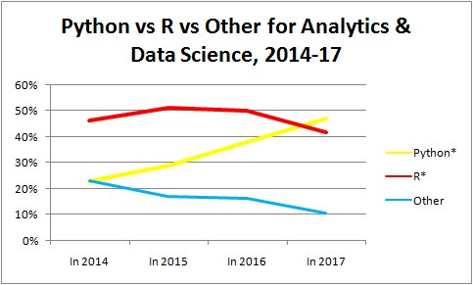
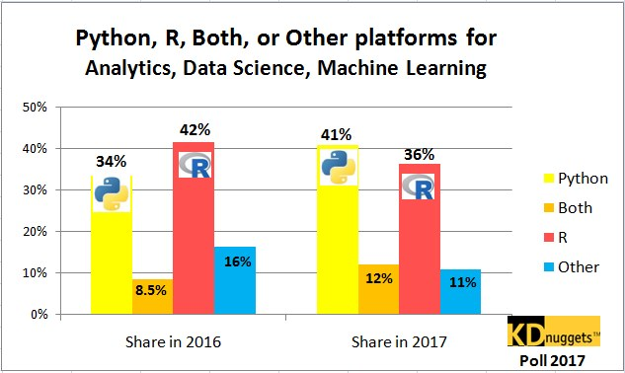
The trend for R
kdnuggets
Notes:
http://www.kdnuggets.com/polls/2015/analytics-data-mining-data-science-software-used.html

Slide 51
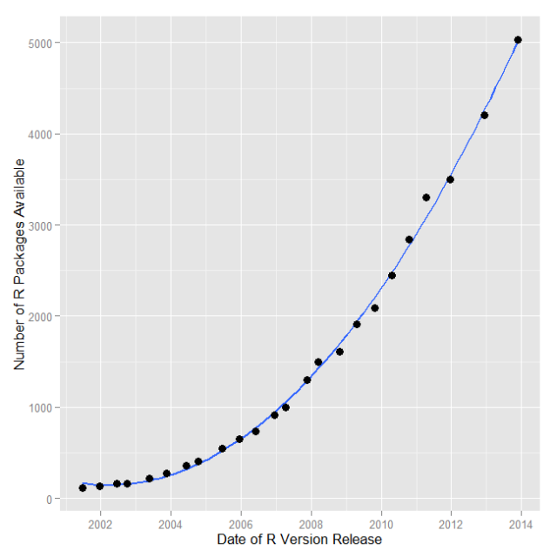
R packages
https://cloud.r-project.org/
Notes:
http://mirrors.ustc.edu.cn/CRAN/

Slide 52
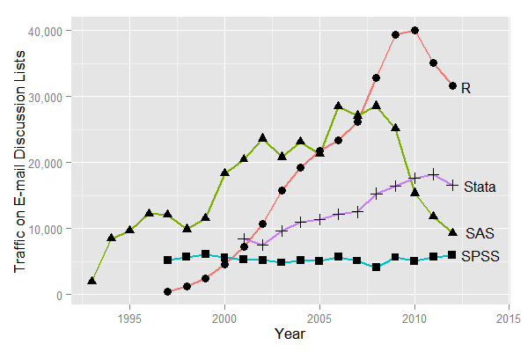
R users

Slide 53

Cross platform

Slide 54
Interact with other software
Database: ORACLE,DB2,MySQL
Language: Java,C, C++,Python
Web
Statistical software: SAS,SPSS, Statistica

Slide 55
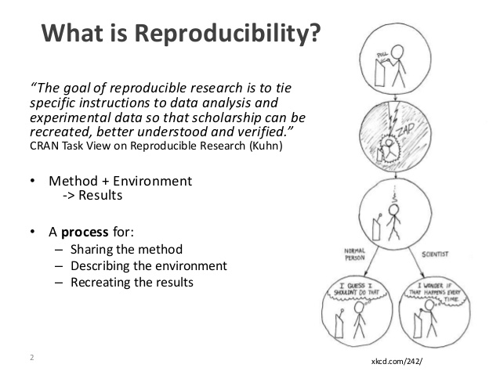
Reproduciblity

Slide 56
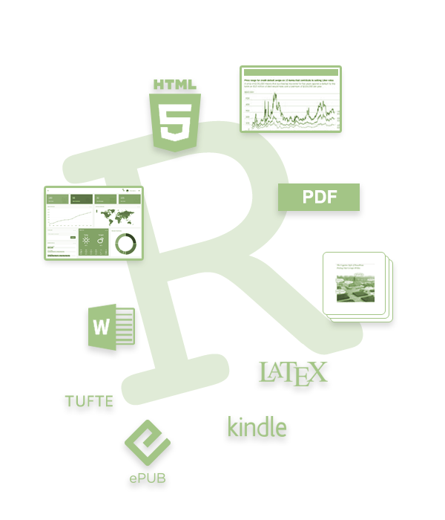
Reproduciblity

Slide 57
Disadvantage of R
Not for dummies: Need to program!!!
black box
import———————> export

Slide 58
Disadvantage of R
Efficiency(non-parallel): interpreted programming language,single threaded
Power (vs. SAS): memory bound
As a Language, it is not perfect

Slide 59
Style

Slide 60
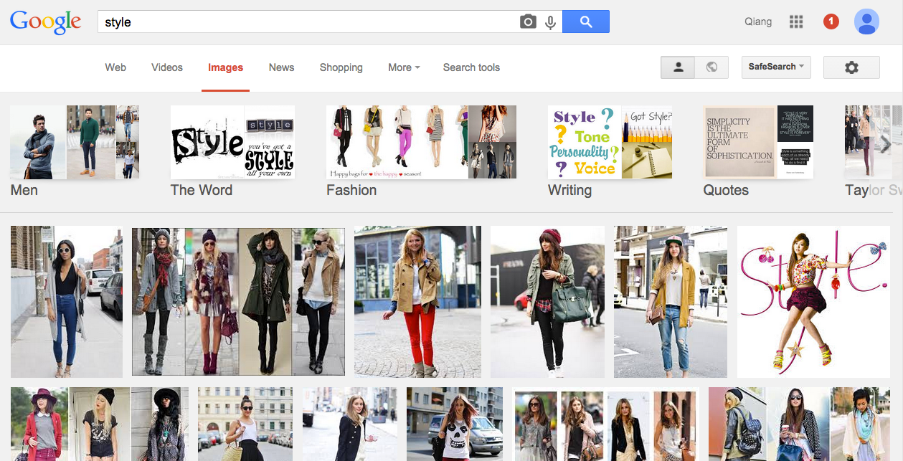
Not the style like this…

Slide 61
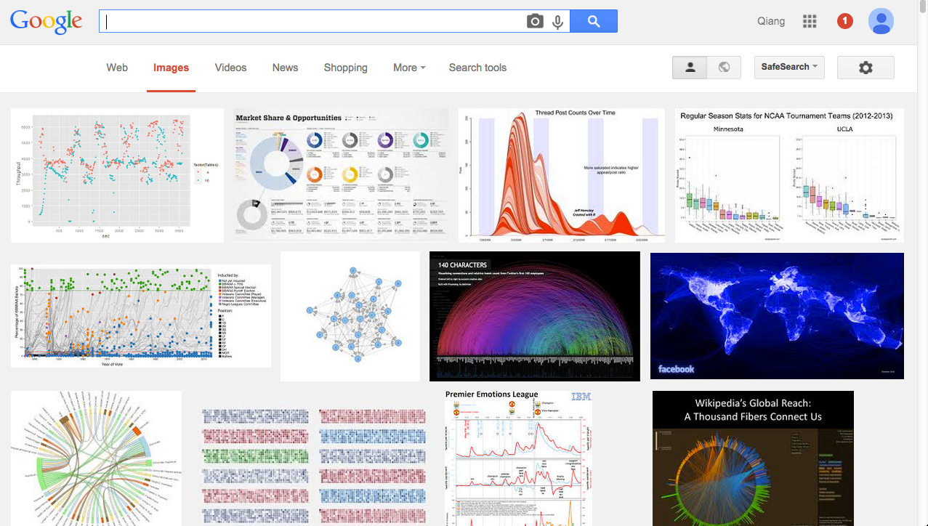
like this?

Slide 62
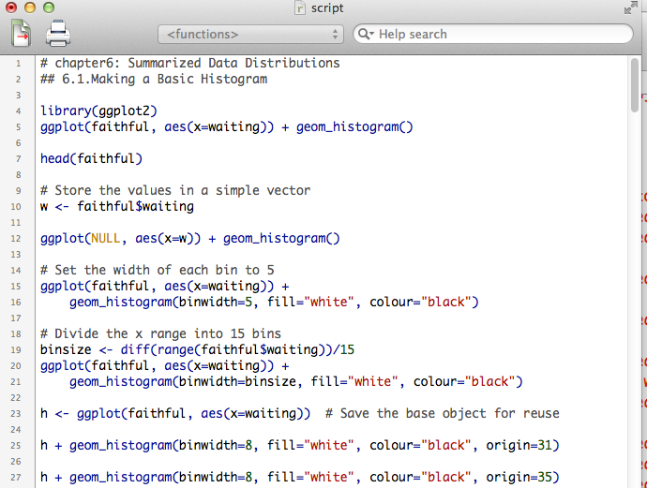
The reality is…

Slide 63
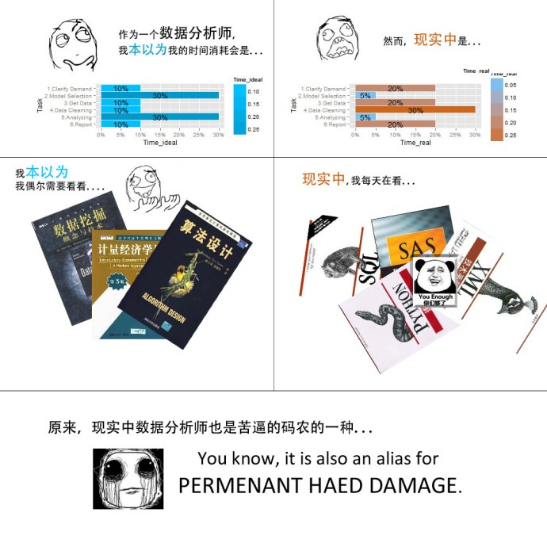
aspiration
reality

Slide 64

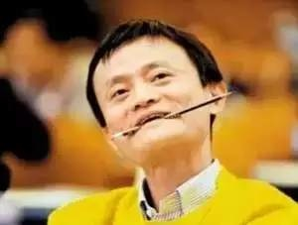

the dream is plump while the reality is skinny

Slide 65

We‘d better have a dream, in case it comes true someday. --Jack Ma?

Slide 66
R You Ready?!

Slide 67
Practice make perfect！

Slide 68



R
www.r-project.org
The engine
Rstudio
www.rstudio.org
The pretty face
Microsoft R Open
mran.microsoft.com/open/
Enhanced R distribution

Slide 69

Statistical software: R user
Programming language: R developer

